Slide 1
EM Wave
info

Slide 2







Some basic wave knowledge is good
$$Wave equation$$
$$How to identify ω$$
$$How to identify k$$
$$What is ω/k$$
$$v=λ×f$$
$$How to see wave direction$$
$Wave parameter like$Time period, Frequency, Wavelength, Propagation constant,

Slide 3
Displacement current

Slide 4




Displacement current
Let us consider an Ampere loop around a plate of capacitor.
$$\oint{B.dl}$$
$$=μ_{o}I_{in}$$
?
Now same boundary but different surface as shown
$$\oint{B.dl}$$
$$=0$$

Slide 5




?
So there is current
Whose cause is not flowing charge
Whose cause is changing electric flux
Displacement current
And this current is called
Current
Conduction current
Displacement current
$$\frac{dq}{dt}$$
Due to Flow of charge
$$I_{c}=$$
Due to changing electric flux
$$ε_{o}\frac{dφ_{e}}{dt}$$
$$I_{d}=$$

Slide 6






1
In circuit $I_{c}=I_{d}$
$$=\frac{dq}{dt}$$
$$=\frac{dCV}{dt}$$
$$=\frac{d\left(\frac{Aε_{o}}{l}\right)E×l}{dt}$$
$$=ε_{o}\frac{dE.A}{dt}$$
$$=ε_{o}\frac{dφ_{e}}{dt}$$

Slide 7
2
It have all property like normal current

Slide 8





3
Current is a zone is $∝$ Area
$$As I_{d}=ε_{o}\frac{dφ}{dt}$$
$$=ε_{o}\frac{dBA}{dt}$$
Make circuit and show this
It have all property like normal current

Slide 9
Maxwell Equation

Slide 10

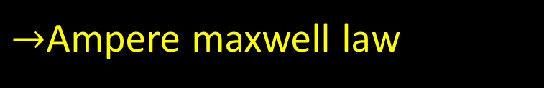

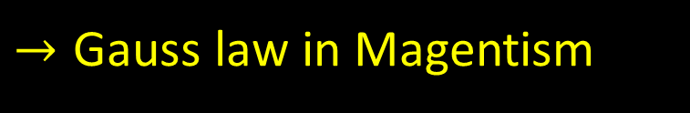




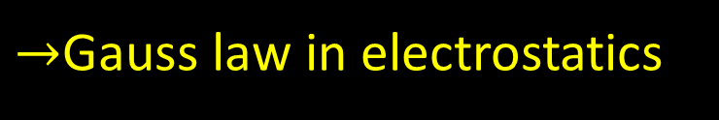
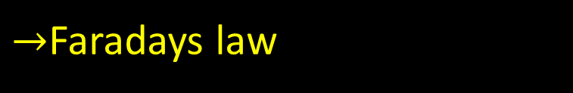



Maxwell Equation
$$\oint{E.ds}$$
$$\oint{E.dl}$$
$$=−\frac{dφ}{dt}$$
$$=\frac{q_{in}}{ε_{o}}$$
$→$Gauss law in electrostatics
$→$Faradays law
$$\oint{B.dl=μ_{o}\left[I_{in}+I_{d}\right]}$$
$$\oint{B.ds}$$
$$\oint{B.dl}$$
$$=0$$
$$=μ_{o}\left[I_{in}+I_{d}\right]$$
$→\text{Gauss} \text{law} \text{in}$Magentism
$→$Ampere maxwell law

Slide 11
Maxwell wave theory

Slide 12
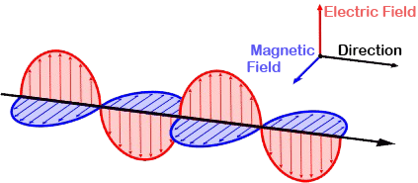



Maxwell wave theory
$$E=E_{o}sin\left(ωt−kx\right)\hat{j}$$
$$B=B_{o}sin\left(ωt−kx\right)\hat{k}$$
$$EM wave$$

Slide 13















All basic property of sin
$$E_{rms}=$$
$$E_{o}/\sqrt{2}$$
$$B_{rms}=$$
$$B_{o}/\sqrt{2}$$
$$E_{avg}=$$
$$0$$
$$B_{avg}=$$
$$0$$
Direction and phase
Direction of EM wave
$$=Along \vec{E}×\vec{B}$$
$$E=E_{o}sin\left(ωt−kx\right)\hat{j}$$
E and B phase difference
$$B=B_{o}sin\left(ωt−kx\right)\hat{k}$$
$$=0$$
$→$Same phase
$$EM wave$$
Direction of E and B is
$=$ Perpendicular plane

Slide 14



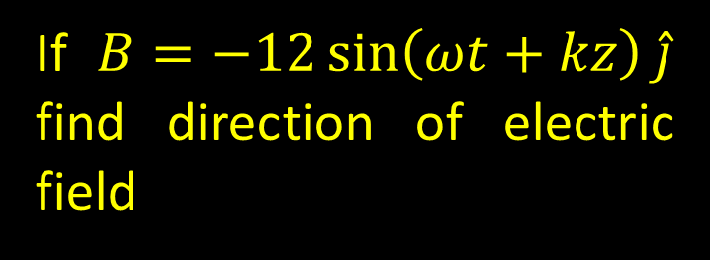



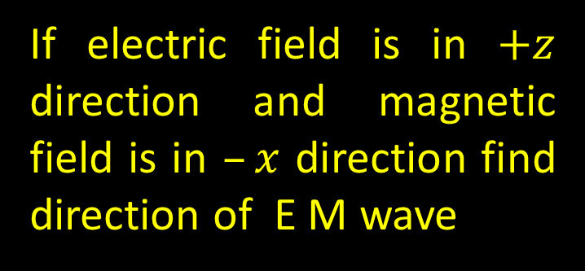






Question
$$+z$$
E $→$
If electric field is in $+z$ direction and magnetic field is in $–x$ direction find direction of E M wave
B$→$
$$−x$$
Velocity $?$
From left hand rule
Question
$$⇒$$
If $B=−12\sin\left(ωt+kz\right)\hat{j}$ find direction of electric field
B$→$
$$−y$$
$$E=E_{o}sin\left(ωt−kx\right)\hat{j}$$
$$B=B_{o}sin\left(ωt−kx\right)\hat{k}$$
Velocity $→$
$$−z$$
E $?$
$$EM wave$$
From left hand rule
$$⇒$$

Slide 15





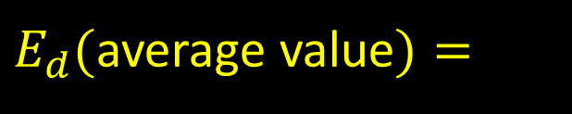



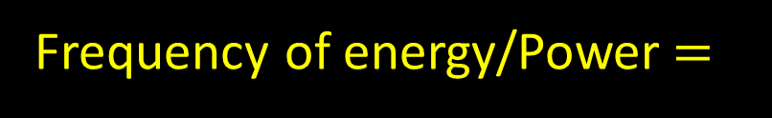
Energy discussion
Energy is equally distributed in Electric and magnetic form
$$\frac{1}{2}ε_{o}E^{2}+\frac{1}{2}\frac{B^{2}}{μ_{o}}$$
Here we have E and B not $E_{o}$ and $B_{o}$ or $E_{rms}$ and $B_{rms}$
$E_{d}=$
$$=2×\frac{1}{2}ε_{o}E^{2}$$
$$E=E_{o}sin\left(ωt−kx\right)\hat{j}$$
$$=ε_{o}{(E_{o}sin\left(ωt−kx\right))}^{2}$$
$$B=B_{o}sin\left(ωt−kx\right)\hat{k}$$
$E_{d}($average value$)=$
$$=1/2×ε_{o}E_{o}^{2}$$
$$=ε_{o}E_{rms}^{2}$$
$$EM wave$$
Frequency of energy/Power$=$
$$2ω$$

Slide 16




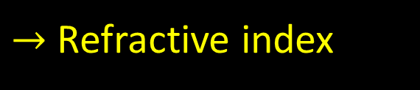









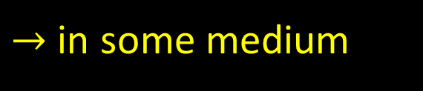

Velocity discussion
$$=ω/k$$
$$=3×{10}^{8}$$
Speed of light
Light is also EM wave
$$=c$$
$$c=\frac{E}{B}$$
$$=\frac{E_{o}}{B_{o}}$$
$$=\frac{E_{rms}}{B_{rms}}$$
$$=\frac{1}{\sqrt{μ_{o}ε_{o}}}$$
$→$ in some medium
$$E=E_{o}sin\left(ωt−kx\right)\hat{j}$$
$$v=\frac{E}{B}$$
$$=\frac{1}{\sqrt{με}}$$
$$B=B_{o}sin\left(ωt−kx\right)\hat{k}$$
$→$ Refractive index
$$=\sqrt{\frac{με}{μ_{o}ε_{o}}}$$
$$EM wave$$
$$=\frac{c}{v}$$
$$=\frac{1/\sqrt{μ_{o}ε_{o}}}{1/\sqrt{με}}$$
$$=\sqrt{μ_{r}ε_{r}}$$
$$1/\sqrt{με}$$

Slide 17
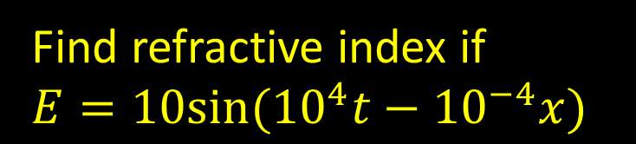
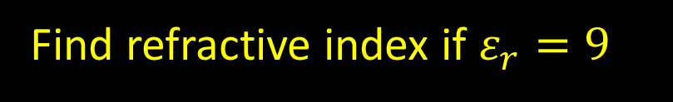
Question
Find refractive index if $ε_{r}=9$
Question
Find refractive index if
$E=10sin⁡({10}^{4}t−{10}^{−4}x)$
$$E=E_{o}sin\left(ωt−kx\right)\hat{j}$$
$$B=B_{o}sin\left(ωt−kx\right)\hat{k}$$
$$EM wave$$

Slide 18


Pointing vector
Poynting Vector represents energy flowing per unit area per unit time in an electromagnetic field
$$=\frac{\vec{E}×\vec{B}}{μ_{o}}$$
$$\left(\vec{S}\right)=$$

Slide 19











Pointing vector
Direction
$$=\frac{\vec{E}×\vec{B}}{μ_{o}}$$
$$\left(\vec{S}\right)=$$
In the direction of EM wave
i.e $\vec{E}×\vec{B}$
Magnitude
$$=\frac{\vec{E}×\vec{B}}{μ_{o}}$$
$$=\frac{EB}{μ_{o}}$$
$$=\frac{(cB) B}{μ_{o}}$$
$$=\frac{(cB^{2}) }{μ_{o}}$$
$$=2×\frac{1}{2}\frac{(cB^{2}) }{μ_{o}}$$
$=c×$Energy density
$$=\frac{l}{t}×\frac{E_{energy}}{A×l}$$
$=$ Instantaneous Energy flowing per unit are per unit time
$=$ Instantaneous
Intensity

Slide 20

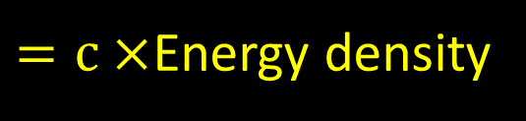

NOTE:
Intensity
$=c×$Energy density
If instantaneous
than instantaneous
$$=ε_{o}E_{ }^{2}$$
If Average
than Average
$$=ε_{o}E_{rms}^{2}$$
NOTE:
Suppose power of a bulb is given as 400W then this is
Average power

Slide 21
Relating power Intensity Electric field Amplitude
NOTE: If a charge is oscillating with frequency f it produce EM wave of frequency f

Slide 22
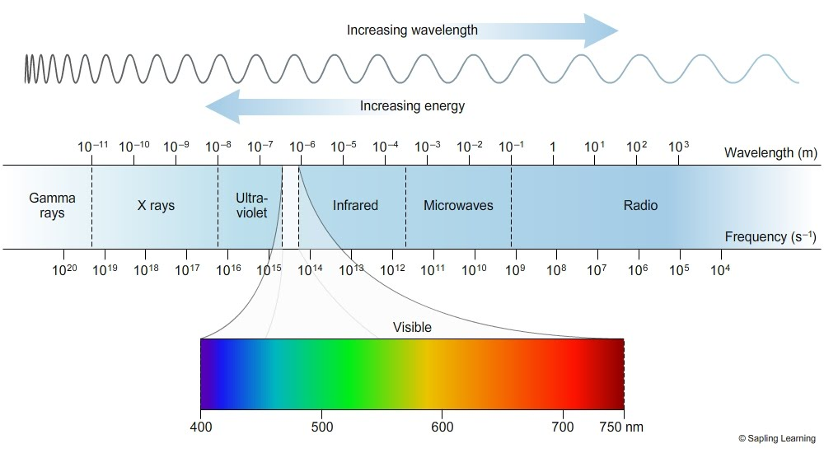

$$V I B G Y O R$$

Slide 23
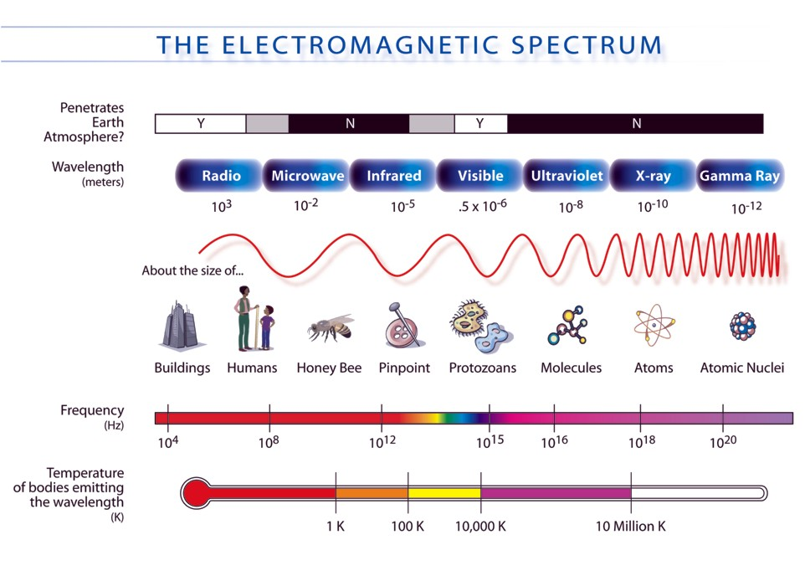

$$⇒f=\frac{c}{λ}$$

Slide 24
Home work

Slide 25
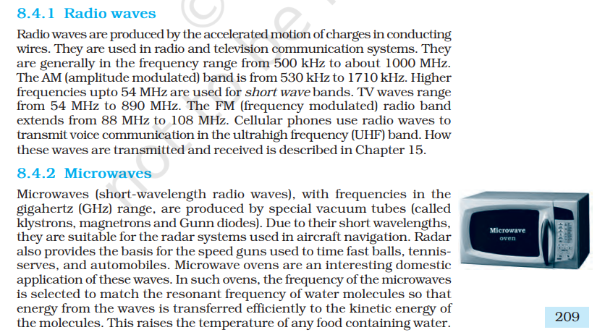

Slide 26
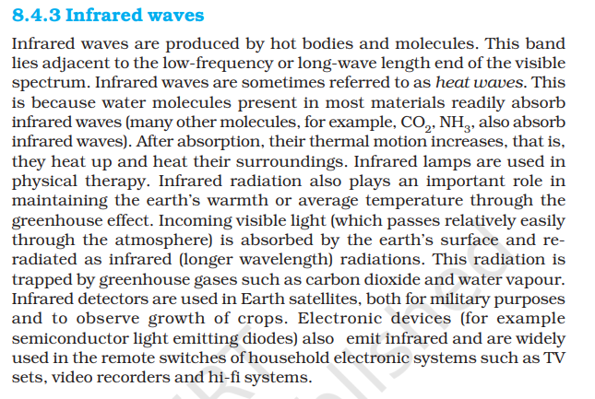

Slide 27
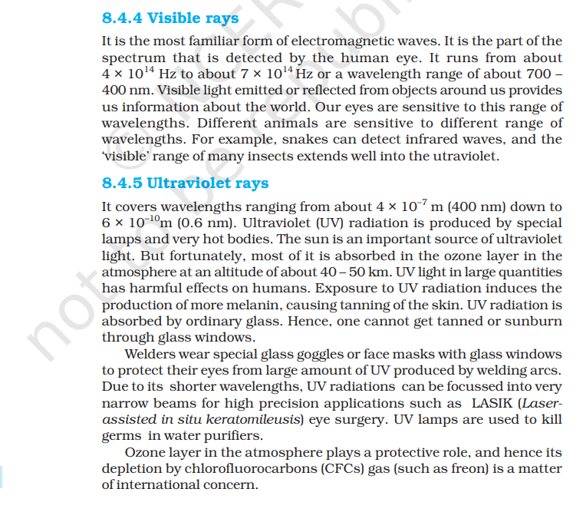

Slide 28
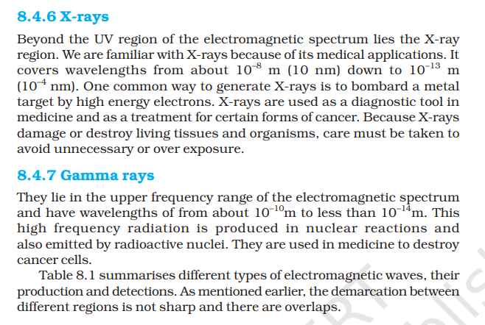

Slide 29
